Slide 1

Dependency Injection
By Min Thet Naing

Slide 2
Problem with Tight coupling between classes
By Min Thet Naing

Slide 3
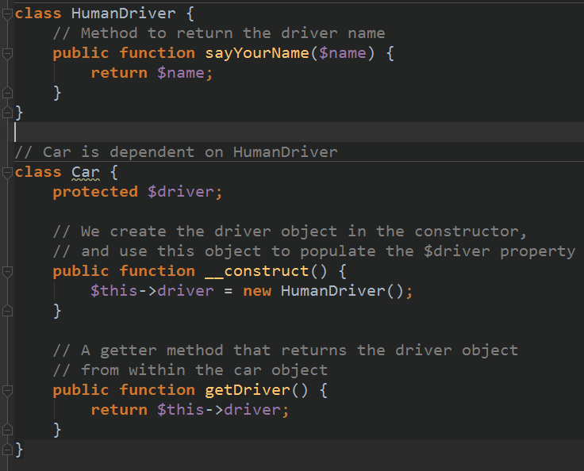
By Min Thet Naing

Slide 4
By Min Thet Naing

Slide 5
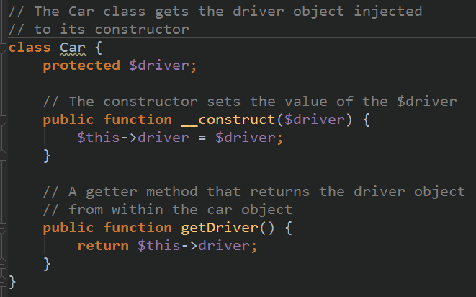
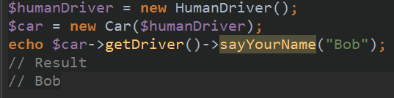
Human Driver class က ေန
RobotDriver class ကိုေျပာင္းခ်င္တယ္ဆိုဘိုလုပ္မလဲ
By Min Thet Naing

Slide 6
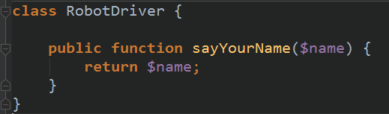
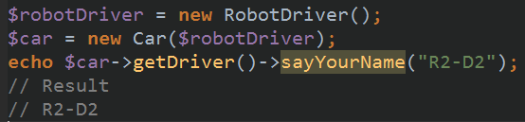
Car class ကိုျပင္စရာလိုေသးလား?
By Min Thet Naing

Slide 7
Why is it a good idea to type hint the injected objects?
By Min Thet Naing

Slide 8
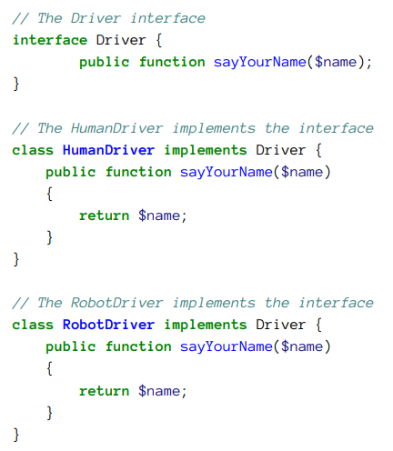
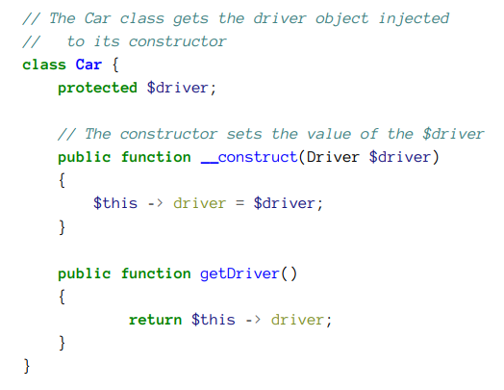
By Min Thet Naing

Slide 9
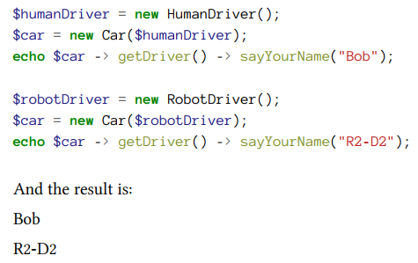
By Min Thet Naing

